Slide 1
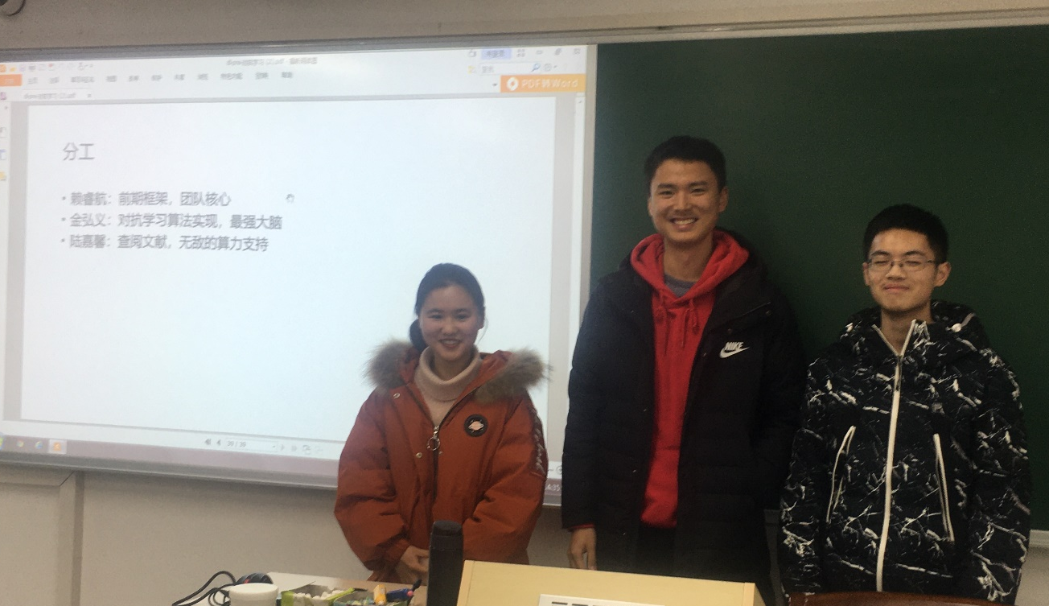
基于数据混合的对抗攻击与防御
赖睿航（中） 金弘义（右） 陆嘉馨（左）
Mentor: 史良良
2020-12-16

Slide 2
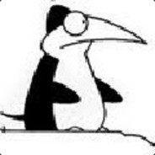

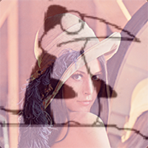
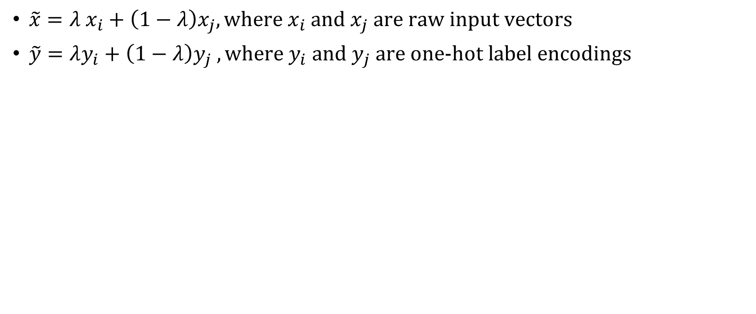
mixup
$\tilde{x}=λ x_{i}+\left(1−λ\right)x_{j}, \text{where} x_{i} \text{and} x_{j} \text{are} \text{raw} \text{input} \text{vectors}$
$\tilde{y}=λy_{i}+\left(1−λ\right)y_{j} , \text{where} y_{i} \text{and} y_{j} \text{are} \text{one}\text{−}\text{hot} \text{label} \text{encodings}$
coderaka | lena
1 | 0
coderaka | lena
0 | 1
coderaka | lena
0.5 | 0.5
Madry, Aleksander, et al. "Towards deep learning models resistant to adversarial attacks." arXiv preprint arXiv:1706.06083 (2017).

Slide 3
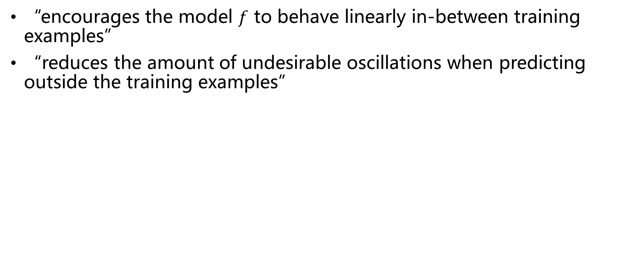
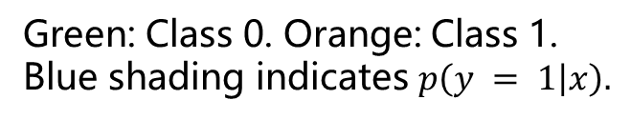
Why mixup?
“encourages the model $f$ to behave linearly in-between training examples”
“reduces the amount of undesirable oscillations when predicting outside the training examples”
Green: Class 0. Orange: Class 1.
Blue shading indicates $p\left(y = 1 | x\right).$
Madry, Aleksander, et al. "Towards deep learning models resistant to adversarial attacks." arXiv preprint arXiv:1706.06083 (2017).

Slide 4
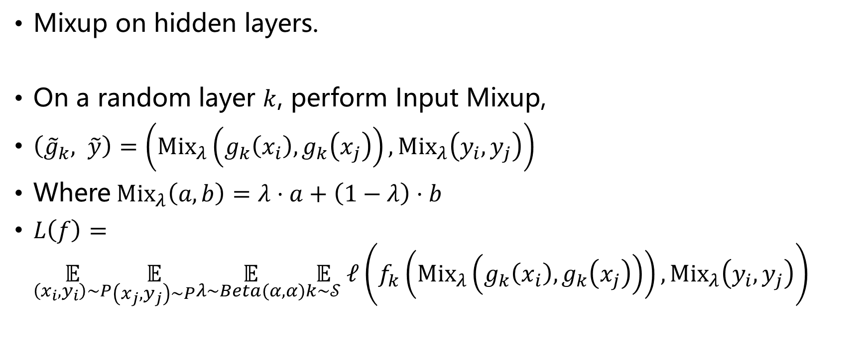
Manifold mixup
Mixup on hidden layers.
On a random layer $k$, perform Input Mixup,
$\left({\tilde{g}}_{k}, \tilde{y}\right)=\left({\text{Mix}}_{λ}\left(g_{k}\left(x_{i}\right),g_{k}\left(x_{j}\right)\right),{\text{Mix}}_{λ}\left(y_{i},y_{j}\right)\right)$
Where${\text{Mix}}_{λ}\left(a,b\right)=λ⋅a+\left(1−λ\right)⋅b$
$L\left(f\right)=\underset{\left(x_{i},y_{i}\right)∼P}{𝔼}\underset{\left(x_{j},y_{j}\right)∼P}{𝔼}\underset{λ∼Beta(α,α)}{𝔼}\underset{k∼𝒮}{𝔼} ℓ\left(f_{k}\left({\text{Mix}}_{λ}\left(g_{k}\left(x_{i}\right),g_{k}\left(x_{j}\right)\right)\right),{\text{Mix}}_{λ}\left(y_{i},y_{j}\right)\right)$
Verma, Vikas, et al. "Manifold mixup: Better representations by interpolating hidden states." International Conference on Machine Learning. PMLR, 2019.

Slide 5
Why manifold mixup?
smoothens decision boundaries (a to b)
improves the arrangement of hidden representations and encourages broader regions of low-confidence predictions (c to d)
a
b
c
d
Verma, Vikas, et al. "Manifold mixup: Better representations by interpolating hidden states." International Conference on Machine Learning. PMLR, 2019.

Slide 6
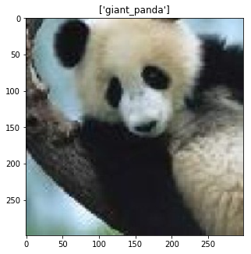
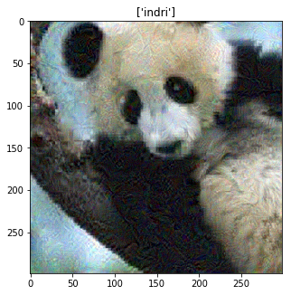
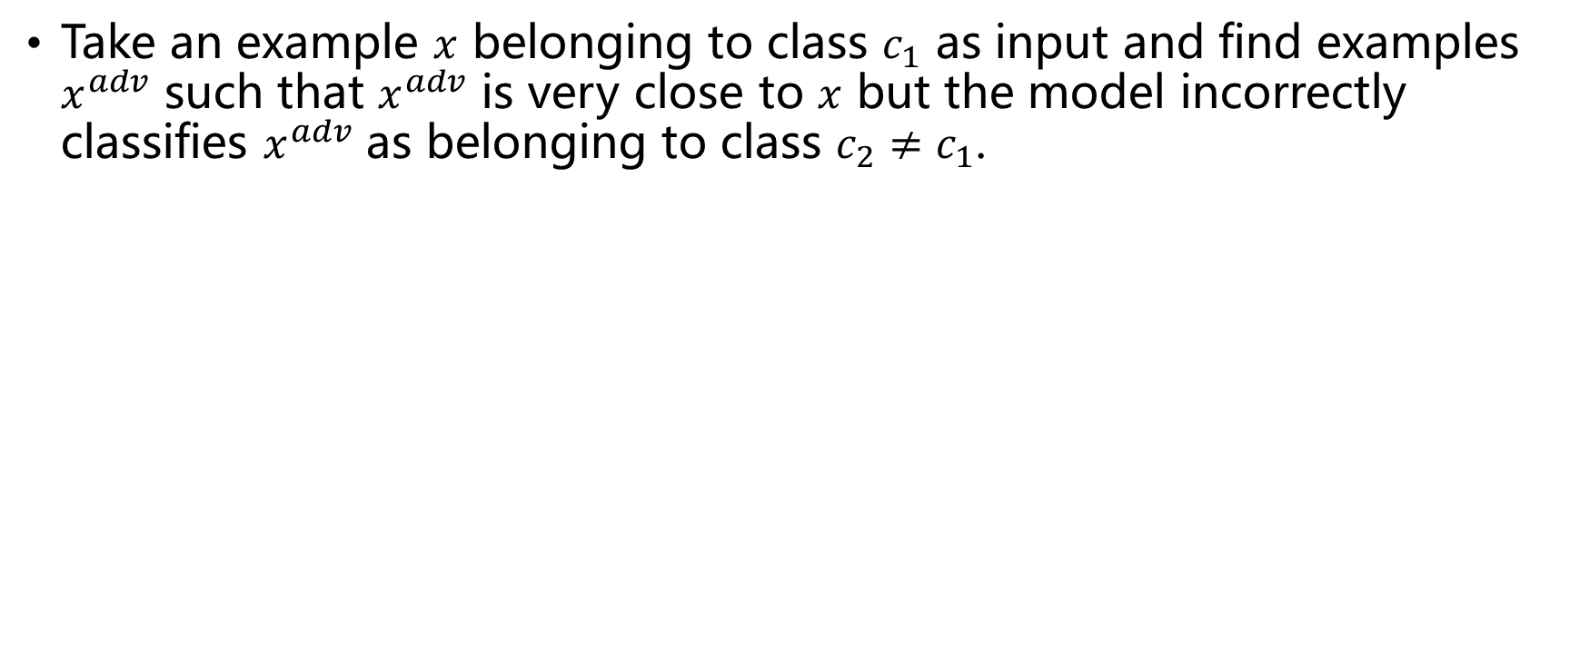
Adversaries
Take an example $x$ belonging to class $c_{1}$ as input and find examples $x^{adv}$ such that $x^{adv}$ is very close to $x$ but the model incorrectly classifies $x^{adv}$ as belonging to class $c_{2}≠c_{1}$.
Madry, Aleksander, et al. "Towards deep learning models resistant to adversarial attacks." arXiv preprint arXiv:1706.06083 (2017).

Slide 7
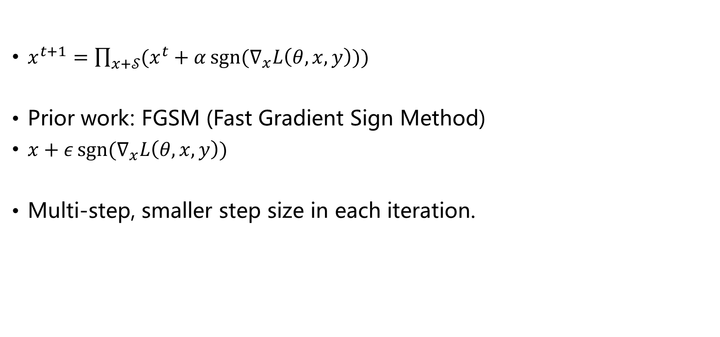
PGD (Projected Gradient Descent)
$x^{t+1}=\prod_{x+𝒮}{(x^{t}+α\operatorname{sgn}{(∇_{x}L\left(θ,x,y\right))})}$
Prior work: FGSM (Fast Gradient Sign Method)
$x+ε\operatorname{sgn}{(∇_{x}L\left(θ,x,y\right))}$
Multi-step, smaller step size in each iteration.
Madry, Aleksander, et al. "Towards deep learning models resistant to adversarial attacks." arXiv preprint arXiv:1706.06083 (2017).

Slide 8
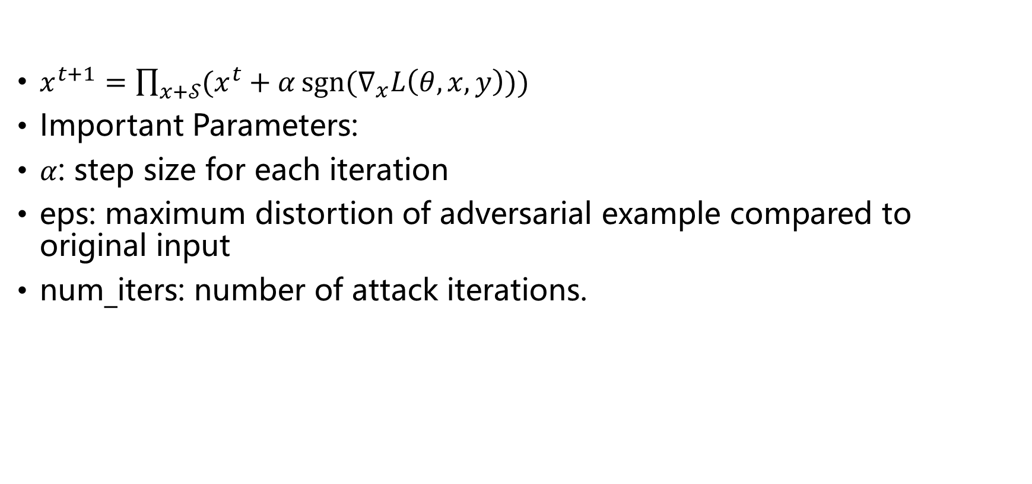
PGD (Projected Gradient Descent)
$x^{t+1}=\prod_{x+𝒮}{(x^{t}+α\operatorname{sgn}{(∇_{x}L\left(θ,x,y\right))})}$
Important Parameters:
$α$: step size for each iteration
eps: maximum distortion of adversarial example compared to original input
num_iters: number of attack iterations.

Slide 9
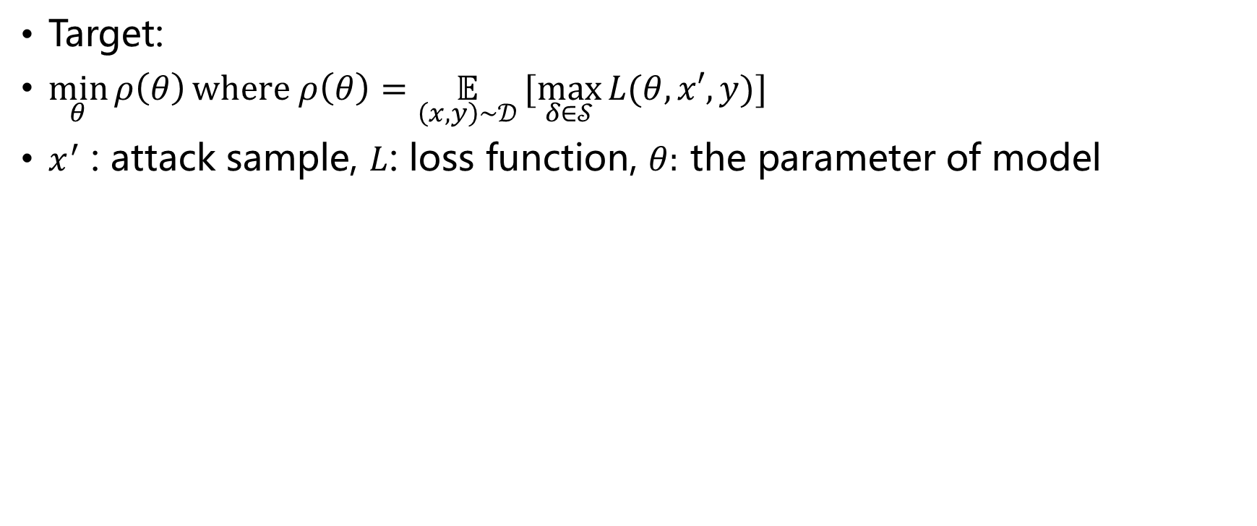
Adversarial Training
Target:
$\min_{θ}{ρ\left(θ\right)}\text{where} ρ\left(θ\right)=\underset{\left(x,y\right)∼𝒟}{𝔼}[\max_{δ∈𝒮}{L(θ,x′,y)]}$
$x^{′}$ : attack sample, $L$: loss function, $θ:$ the parameter of model
Madry, Aleksander, et al. "Towards deep learning models resistant to adversarial attacks." arXiv preprint arXiv:1706.06083 (2017).

Slide 10
Adversarial Training + mixup
manifold mixup 总体类似，唯一的不同是mixup在模型的隐层进行

Slide 11
What needed for adversarial training?
Capacity.
FGSM adversaries don't increase robustness. (Use PGD.)
Weak models may fail to learn non-trivial classifiers.
Madry, Aleksander, et al. "Towards deep learning models resistant to adversarial attacks." arXiv preprint arXiv:1706.06083 (2017).

Slide 12
Experiments on Mixup & PGD

Slide 13
Mixup & Manifold Mixup
如何实现 Mixup/Manifold Mixup？
①
Conv2d + ReLU +Pooling
②
Conv2d + ReLU +Pooling
Mixup: ①
Manifold Mixup: ① ② ③ ④ ⑤ (u.a.r)
③
LeNet5
FullyConnected + ReLU
④
FullyConnected + ReLU
⑤
FullyConnected

Slide 14
Mixup & Manifold Mixup
如何实现 Mixup/Manifold Mixup？
1. Label: 0~9 → One-hot encoding
1. Cross Entropy Loss → Binary Cross Entropy Loss (when training)
2. 与谁混合？
Batch indices
Shuffled indices
New Batch
0
1
2
3
4
2
0
4
3
1
λx[0]+(1-λ)x[2]
λx[1]+(1-λ)x[0]
λx[2]+(1-λ)x[4]
λx[3]+(1-λ)x[3]
λx[4]+(1-λ)x[1]
shuffle
mix

Slide 15
Experiments – Start Up
在 MNIST 和 CIFAR-10 数据集上，使用 vanilla (无 mixup)、mixup 和 manifold mixup 三种方法各训练一个模型

Slide 16
Experiments – Start Up
MNIST, LeNet5
500 epochs, learning rate 0.1, SGD optimizer with momentum 0.9
Model | Accuracy on Test Set(%) | Cross-Entropy Loss
Vanilla | 99.30 | 0.022
Mixup | 99.31 | 0.048
Manifold Mixup | 99.44 | 0.076

Slide 17
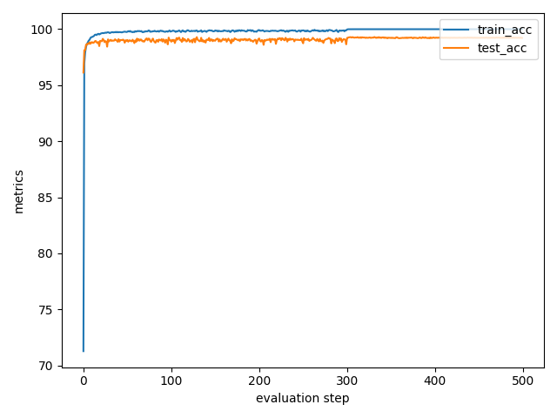
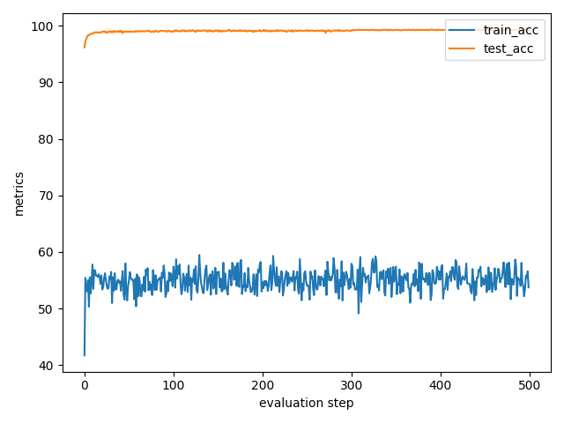
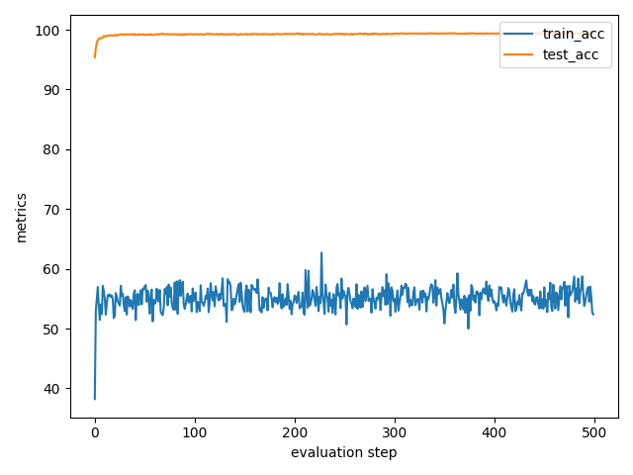
Experiments – Start Up
Accuracies on MNIST
Vanilla
Mixup
Manifold Mixup

Slide 18
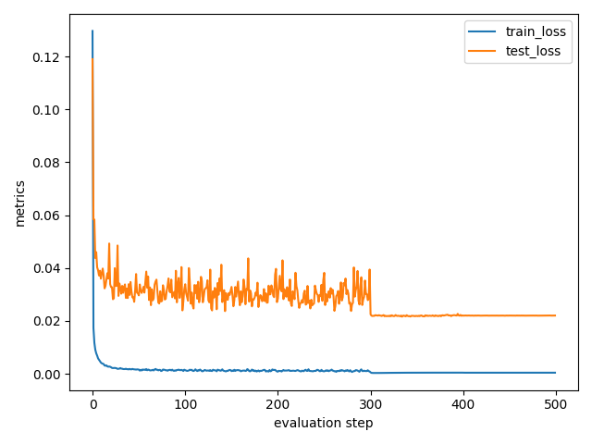
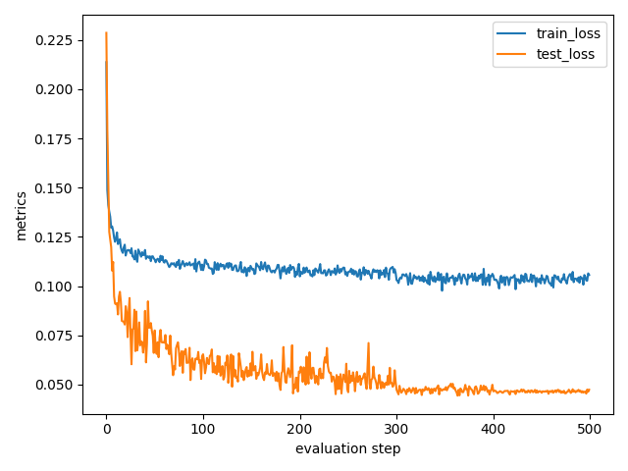
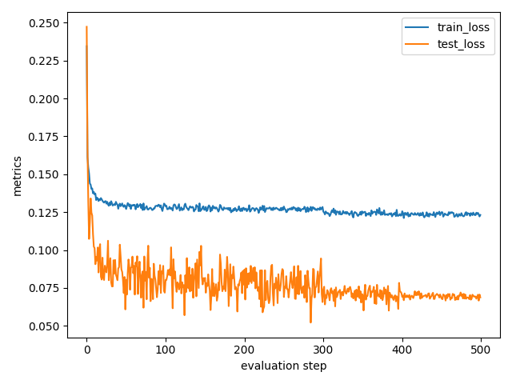
Experiments – Start Up
Losses on MNIST
Vanilla
Mixup
Manifold Mixup

Slide 19
Experiments – Start Up
CIFAR-10, PreActResNet18
2000 epochs, learning rate 0.1, SGD optimizer with momentum 0.9
Model | Accuracy on Test Set(%) | Cross-Entropy Loss
Vanilla | 95.58 | 0.172
Mixup | 96.89 | 0.186
Manifold Mixup | 97.19 | 0.161

Slide 20
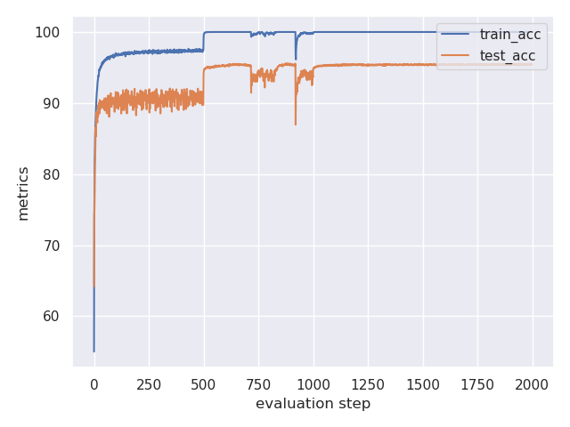
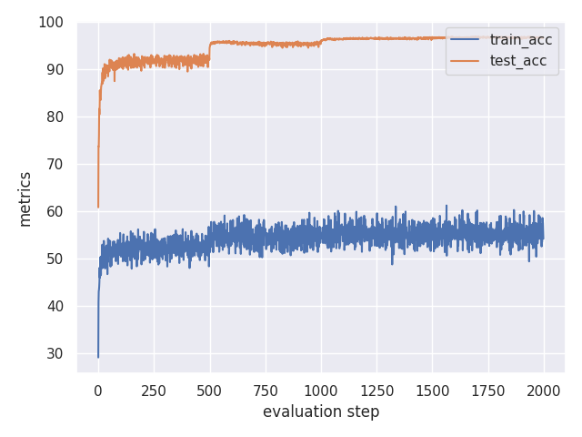
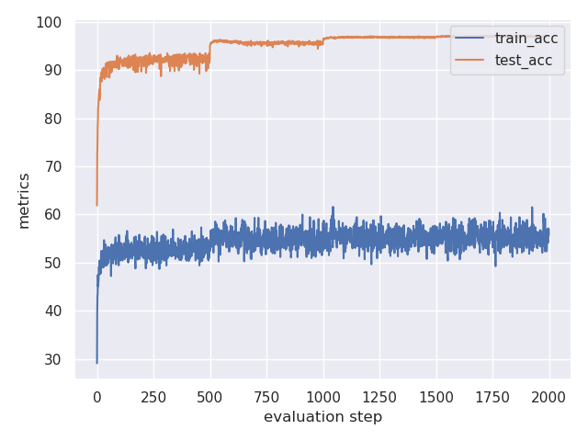
Experiments – Start Up
Accuracies on CIFAR-10
Vanilla
Mixup
Manifold Mixup

Slide 21
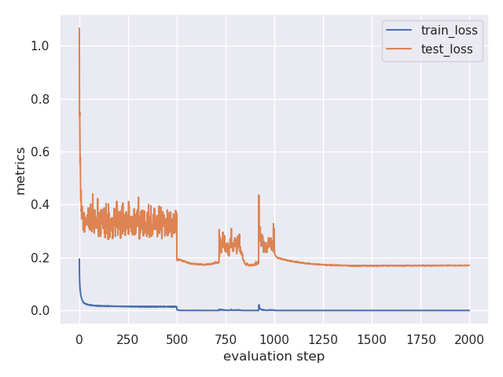
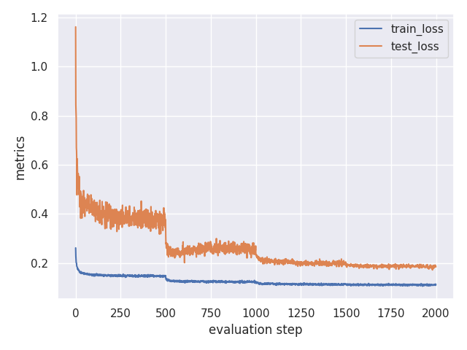
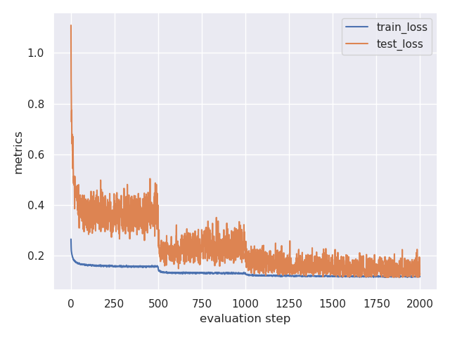
Experiments – Start Up
Losses on CIFAR-10
Vanilla
Mixup
Manifold Mixup

Slide 22
Experiments – Start Up
直接训一个模型的效果：
Manifold Mixup > Mixup > Vanilla
由于 Mixup 引入的随机性，accuracy 和 loss 存在波动

Slide 23



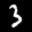



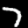

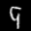
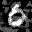
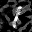
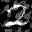
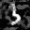
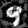
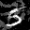
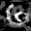
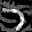
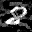
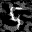
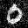
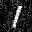
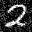
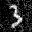
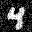

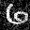
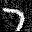
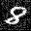
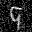
Experiments – PGD Attack
MNIST
eps=0.3, alpha=0.01, num_iters=40
Origin
Attacked from pretrained model
Attacked from untrained model

Slide 24


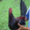
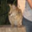
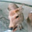

























Experiments – PGD Attack
CIFAR-10
eps=8/225, alpha=2/225, num_iters=7
Origin
Attacked from pretrained model
Attacked from untrained model
airplane
automobile
bird
cat
deer
dog
frog
horse
ship
truck

Slide 25
Experiments – PGD Attack
model在攻击过的测试集上的表现
MNIST
CIFAR-10
Model | Accuracy(%)
Vanilla | 0.00
Mixup | 0.00
Manifold Mixup | 0.01
Model | Accuracy(%)
Vanilla | 5.01
Mixup | 5.02
Manifold Mixup | 5.06

Slide 26




Experiments – PGD Attack
MNIST，轻而易举
CIFAR-10，看起来难一些，但实际上PGD也能取得不错的效果
用 Manifold Mixup 训出来的model在鲁棒性上确实好那么

Slide 27
Experiments on Adversarial Training

Slide 28
Adversarial training

Slide 29
初始模型选择
从空模型开始训练
从预训练模型开始进一步的对抗学习

Slide 30

MNIST
$ε=0.3$, $α=0.01$, run 40 steps of projected gradient descent
 | Training from a pretrained model | Training from an untrained model
Vanilla | 85.81% | 84.26%
Mixup | 90.09% | 72.83%
Manifold mixup | 87.88% | 83.28%
 | Training from a pretrained model | Training from an untrained model
Vanilla | 96.87% | 96.49%
Mixup | 98.13% | 95.73%
Manifold mixup | 97.97% | 96.69%
accuracy on PGD-attacked dataset
accuracy on original dataset
结论：无论是否使用mixup，从预训练模型开始训练都会比从空模型开始训练获得更好的效果

Slide 31

Experiments
We choose to start adversarial training from pretrained models.
PGD parameters:
MNIST:
$ε=0.3$, $α=0.01$, run 40 steps of projected gradient descent
CIFAR-10:
$ε=2/255$, $α=8/255$, run 7 steps of projected gradient descent

Slide 32


Experiments (MNIST)
训练时模型对PGD攻击过的样本的准确率曲线
训练时模型对原始样本的准确率曲线

Slide 33
Experiments (MNIST)
 | standard training | PGD training
Vanilla | 0% | 85.81%
Mixup | 0% | 90.09%
Manifold mixup | 0.01% | 87.88%
 | standard training | PGD training
Vanilla | 99.30% | 96.87%
Mixup | 99.31% | 98.13%
Manifold mixup | 99.44% | 97.97%
accuracy on PGD-attacked dataset
accuracy on original dataset

Slide 34


Experiments (CIFAR-10)
训练时模型对PGD攻击过的样本的准确率曲线
训练时模型对原始样本的准确率曲线

Slide 35
Experiments (CIFAR-10)
 | standard training | PGD training
Vanilla | 5.01% | 24.89%
Mixup | 5.02% | 55.20%
Manifold mixup | 5.06% | 48.57%
 | standard training | PGD training
Vanilla | 95.58% | 78.13%
Mixup | 96.89% | 82.49%
Manifold mixup | 97.19% | 81.92%
accuracy on PGD-attacked dataset
accuracy on original dataset

Slide 36
Conclusion
使用mixup进行PGD对抗学习可以使模型鲁棒性大大提升
对于MNIST，以上述方法训练出的模型在强攻击下依然有很高的准确率
对于CIFAR-10，虽然没有起到同样的效果，但同样展现了上述方法提升了鲁棒性

Slide 37
展望
虽然进行PGD对抗学习可以提高鲁棒性，但会影响它在原始的数据集上的准确率。
CIFAR-10数据集上的准确率下降了14.4%
可以继续研究如何在保证鲁棒性的同时提升准确率，不然可以被更初级的模型替代
此外可以尝试对一张图做pgd攻击，另一张不做，再mixup，对抗学习
还可以对one-hot形式的label增加噪声进行训练，来增加鲁棒性

Slide 38
参考文献
Madry, Aleksander, et al. "Towards deep learning models resistant to adversarial attacks." arXiv preprint arXiv:1706.06083 (2017).
Zhang, Hongyi, et al. "mixup: Beyond empirical risk minimization." arXiv preprint arXiv:1710.09412 (2017).
Verma, Vikas, et al. "Manifold mixup: Better representations by interpolating hidden states." International Conference on Machine Learning. PMLR, 2019.

Slide 39
分工
赖睿航：前期框架，团队核心
金弘义：对抗学习算法实现，最强大脑
陆嘉馨：查阅文献，无敌的算力支持

